Slide 1
NE 795: Advanced Reactor Materials
Fall 2023
Dr. Benjamin Beeler

Slide 2
Last Time
Wrapped up carbides
FCCI, primary concern is carburization, formatting of Cr-C precipitates along grain boundaries and then crystallographic planes; governed by C diffusion into the cladding; FCCI is worse for Na-bonded pins, as C transport to cladding is faster
Carbide fabrication: carbothermic reduction
Started on nitrides
Similar benefits to UC fuels, options for reprocessing, interest from a variety of reactor concepts
UN and U2N3 are main phases
Same pin design types as carbides; similar fuel surface temperature evolution

Slide 3
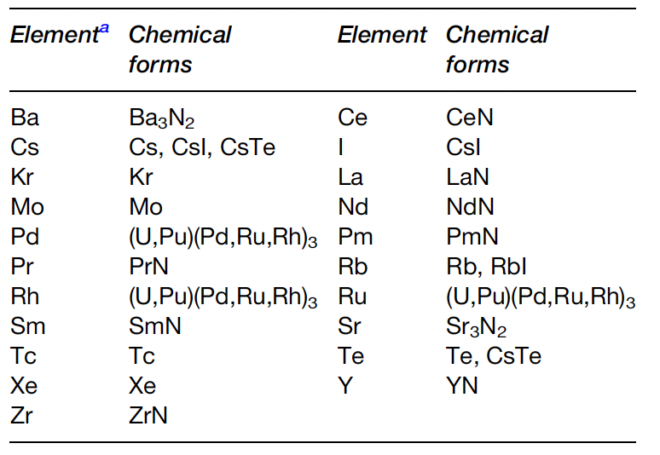
Fission Products
Fission products can form various nitride phases in the fuel matrix
Noble gases will not react with N, and volatile species (Cs, I, Te) will form volatile compounds
Pd, Rh, Ru, Mo, Tc form metallic precipitates
Rare earths and transition metals are dissolved in the U/Pu-N matrix
The N/U ratio was evaluated and reported to increase by 2% at a burnup of 10%
The increase in N can form U2N3 phases

Slide 4
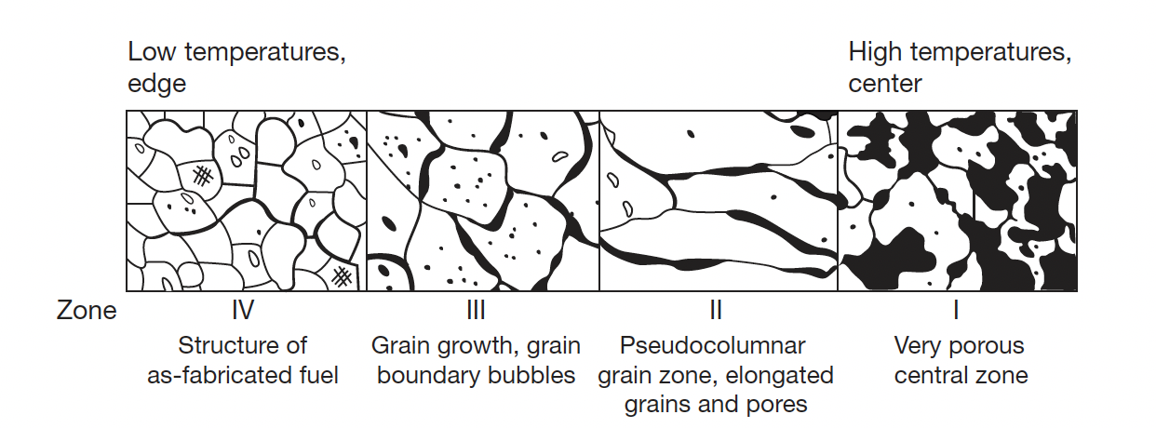
Nitride Restructuring
Because of relatively low fuel temperature and temperature gradient, the restructuring of (U,Pu)N fuel is mild in comparison to MOX fuel for fast reactors
For He bonded pins at high power, restructuring does occur with three distinct zones
Zone 1 is found in the central of the fuel pellet was characterized by very porous structure; a small central hole was sometimes observed (not due to pore migration)

Slide 5
Nitride Restructuring
Zone 2 is found in MOX fuels and sometimes in carbide fuels, but NOT in UN fuels
Zone 3 displays grain growth, grain boundary bubbles, and healing of cracks
Zone 4 has the as-fabricated structure, low swelling, small bubbles
Fission gas release is prevalent in zone 1 and zone 3, with large amount of UN swelling

Slide 6
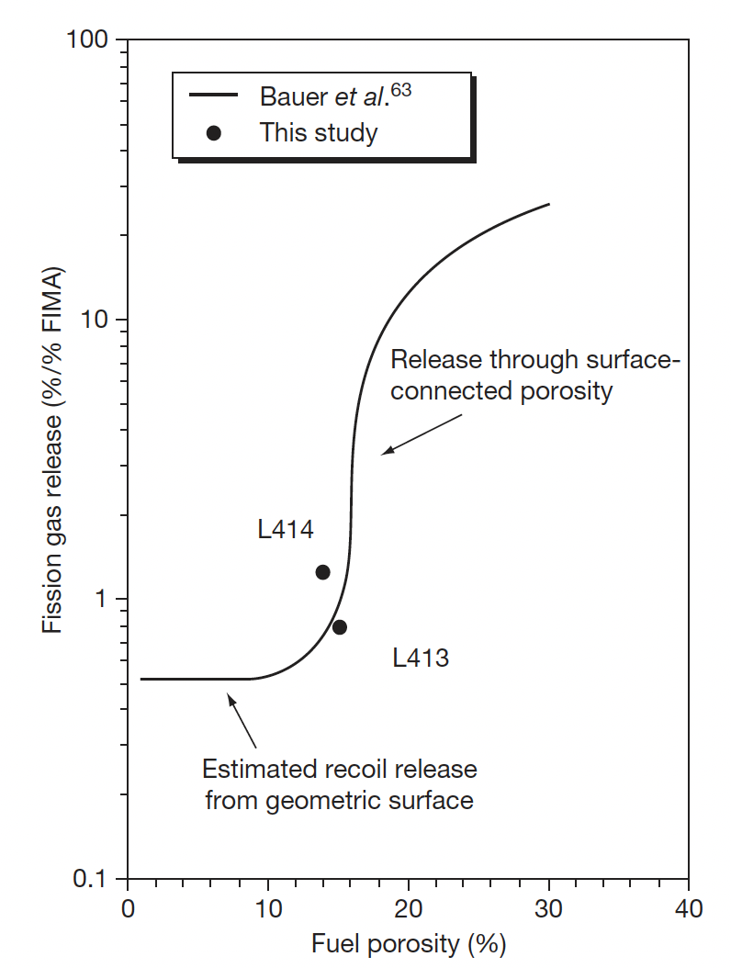
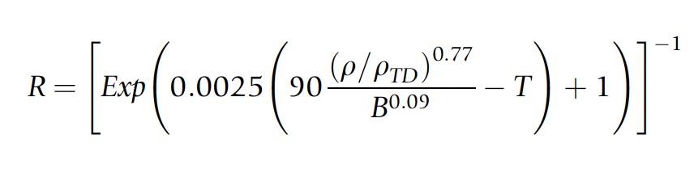
Fission Gas Release
It is generally known that FP gas release of nitride fuel is much lower than that of MOX fuel; Likely due to lower temperatures
There have been no systematic results dealing with fission gas release of nitride fuel, due to limited irradiations
Gas release will be influenced by burnup, pellet density, grain size, the characteristics of porosities, and temperature
Different relations have been developed to account for these factors
Fuel at 4.3% FIMA

Slide 7
Swelling and FCMI
Since FG release is low, its possible that swelling is large
Volumetric swelling is caused by the accumulation of solid FP and crack formation in the pellets
The volumetric swelling rate of (U,Pu)N fuel irradiated to 9.3% FIMA was evaluated at 1.83% per FIMA% without the constraint of the cladding tube
This is considerably higher than UO2 fuels, and lower than metallic fuels
The creep rate of (U,Pu)N fuel is low in comparison with MOX or metallic fuel at operating temperatures due to a slow diffusion rate of metal atoms in nitride fuel
Thus, focus has been placed upon the degree of FCMI in UN fuels
FCMI in a general sense can be mitigated by the reduced TD and operating at a reasonable linear power (<100kW/m)

Slide 8

Swelling and FCMI
High power He-bonded pins with high TD caused a number of cladding failures, leading to suggested conditions of <80 kW/m and TD ~ 75%
Thus, FG swelling is is highly temperature dependent
Solid swelling is estimated at 0.5% per % FIMA
This is significantly lower than metallic fuels
Swelling correlations have been developed taking temperature, burnup, and as-fabricated density into account

Slide 9
FCCI
Similar to carbide fuels, but without the problems of carburization
Pure UN and PuN are stable with respect to most major cladding constituents
Hypostoichiometric MN containing free U or Pu should be avoided as a eutectic melting reaction with the cladding can occur
Formation of (U,Pu)Fe2 and (U,Pu)Ni5-type intermetallic compounds – same as carbides
In systems with excess N, U2N3 can be stripped of N to form Fe, Ni, and Mo nitrides
Thus, hyperstoichiometric UN is less compatible with cladding

Slide 10

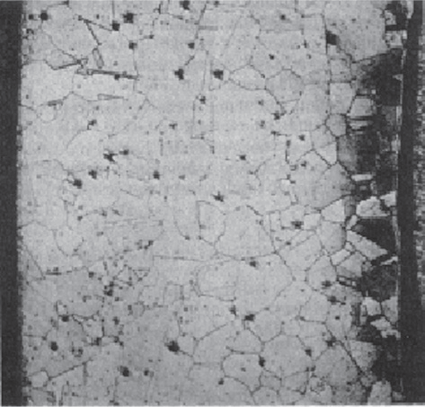
Cladding Nitriding
Hyperstoichiometric MN containing sesquinitride can cause nitrogen penetration and form a reaction layer at the cladding inner surface
Since N/U increases with burnup, more N becomes available with time
Oxygen impurities present can convert the fuel into oxide form, freeing nitrogen and allowing for nitriding
Excessive nitriding of cladding materials has not been reported
Appearance of clad nitriding of Type 304 stainless steel cladding

Slide 11
Reprocessing
Both hydrochemical and pyrochemical processes were proposed for the reprocessing techniques
The disposal of long-lived ¹⁴C and the recovery of expensive ¹⁵N are key topics in reprocessing
Hydrochemical processes include the direct dissolution of spent nitride fuel in HNO3 and the voloxidation of spent nitride fuel followed by the dissolution in HNO3
The product of hydrochemical reprocessing is the nitric solution of U+Pu to be converted to oxide, and then to nitride by carbothermic reduction
Pyrochemical processing similar to that for metallic fuel can also be applied for nitrides
Conversion to an oxide may be performed for the purpose of N-15 recovering via exposure to air

Slide 12
Nitride Fabrication
Similar to carbide fuels, preparation of nitrides from either metallic sources or from the hydriding-dehydriding process were explored in the 1960s and remain an option for laboratory implementation
These reactions are exothermic and should be carried out slowly by temperature cycling for better control of the products
It is difficult to apply the metal or hydride route to a technological fuel production line
These processes include the nitridation of U or Pu metal in N2 or NH3 at 1073–1173 K, arc-melting of U or Pu metal under N2 pressure, nitridation of fine-grained U or Pu powder formed by the decomposition of hydrides with N2 or NH3 and direct reaction of UH3 or PuH_{2.7} with N2 or NH3

Slide 13

Carbothermic Reduction
Carbothermic reduction is the most widely used process for preparing nitride fuel
The starting material is a dioxide and carbon, and the general reaction is
The mixture of dioxide and carbon is heated in N2 gas stream, usually at 1773–1973 K
An excess amount of carbon is usually added to the mixture to reduce the oxygen content
The residual carbon is removed from the products by heating in a N2-H2 stream
The initial C/MO2 mixing ratio was historically chosen at 2.2–2.5 for the preparation of UN and (U,Pu)N
For the preparation of UN and (U,Pu)N, the atmosphere is changed to Ar or He from N2 or N2–H2 to prevent the formation of higher nitrides

Slide 14
Carbothermic Reduction
Typical impurities in nitride fuel prepared by carbothermic reduction are oxygen and carbon
The level of impurities can be kept lower than 1000 ppm for both oxygen and carbon by adjusting the initial C/MO2 mixing ratio
Carbonitrides (U/Pu-C-N) have complete solubility in the MN systems, while oxides have solubility around 10%
MA-N can be manufactured in the same way, but has different C, N, and O potentials, requiring slightly different mixtures of streams
Am also has a high vapor pressure and it is a challenge to keep it from vaporizing during fabrication
This requires operating at lower temperatures for the N2 stream
Unlike carbides, Pu volatilization is not an issue

Slide 15
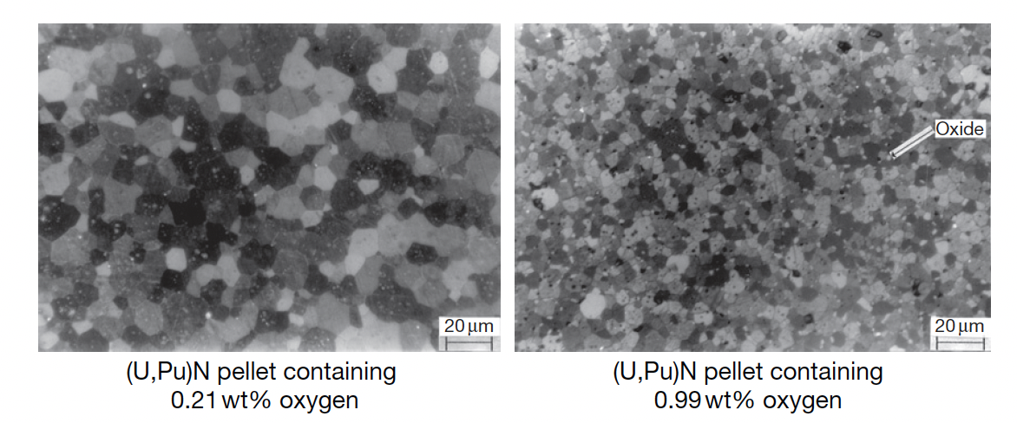
Nitride Pellets
Nitride fuel pellets are usually prepared by a classical powder metallurgical manner; the product of carbothermic reduction is ground to powder by use of a ball mill, pressed into green pellets and sintered in a furnace at 1923–2023 K
Actinide nitride powder has a low sinter-ability in comparison with that of oxide or carbide powder, which is derived from a low diffusion rate of metal atoms in mononitrides
A high sintering temperature (i.e., T>1973 K) is necessary for preparing dense UN or (U,Pu)N pellets higher than 90% TD
Oxygen impurities tend to promote the sintering of UN, but greater than 1 wt% decreases the density and results in an overly fine grain structure

Slide 16
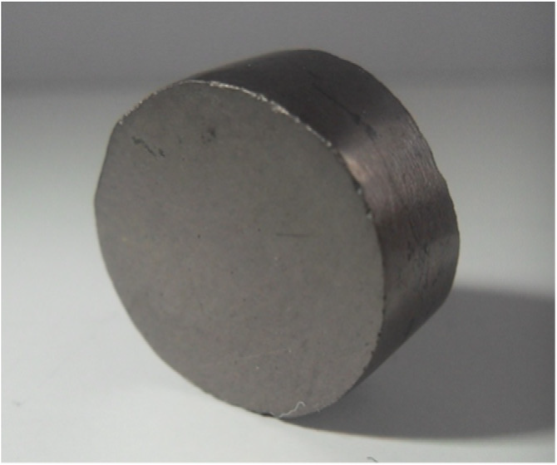
Nitrogen enrichment
Nitrogen enrichment is critical for utilization in thermal reactors, and provides significant benefits for fast reactors
The cost of nitrogen enrichment is currently about 10x that which is needed to economical fuel development
UN pellet produced by spark plasma sintering

Slide 17
Summary
Nitrides have a higher U density and higher thermal conductivity than oxides, with a higher melting point than carbides
Difficult fabrication, requiring atmospheric controls and enrichment of N, especially in thermal or transmutation applications
Carbothermic reduction is the primary fabrication route
Very few irradiations have been performed, none to especially high burnups
Three stages in temperature, with gap closure leading to steady state behavior
Nitride fuel undergoes restructuring, with central porous region, large grained region, and as-fabricated microstructure
FCMI is a key life limiting phenomenon due to little creep in UN fuels

Slide 18
Lead Cooled reactors

Slide 19
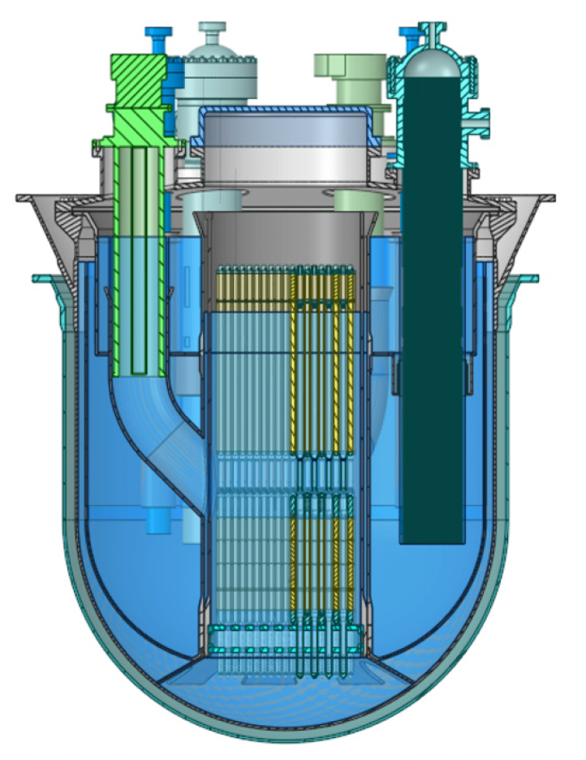
ALFRED Reactor
ALFRED, the advanced lead-cooled fast reactor European demonstrator
ALFRED is a planned demonstrator reactor designed with the specific purpose to test and qualify innovative components and procedures to be used in commercial reactors
Pool type, MOX hollowed fuel pellets, natural and forced circulation
Planned commercial operation in 2035-2040

Slide 20
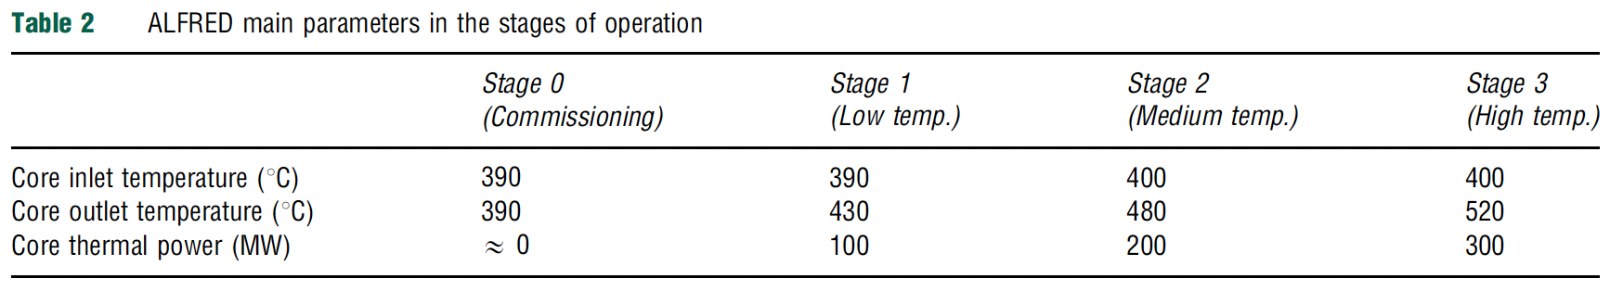
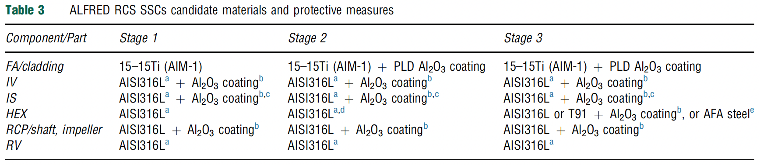
ALFRED Reactor
ALFRED plans to operate in a staged manner for licensing purposes, ramping up activities
Currently planned materials are listed for the different stages, relying heavily on coatings and austenitic steels
An example 15-15Ti steel in the US is D9
Different reactor concepts with different candidate materials

Slide 21
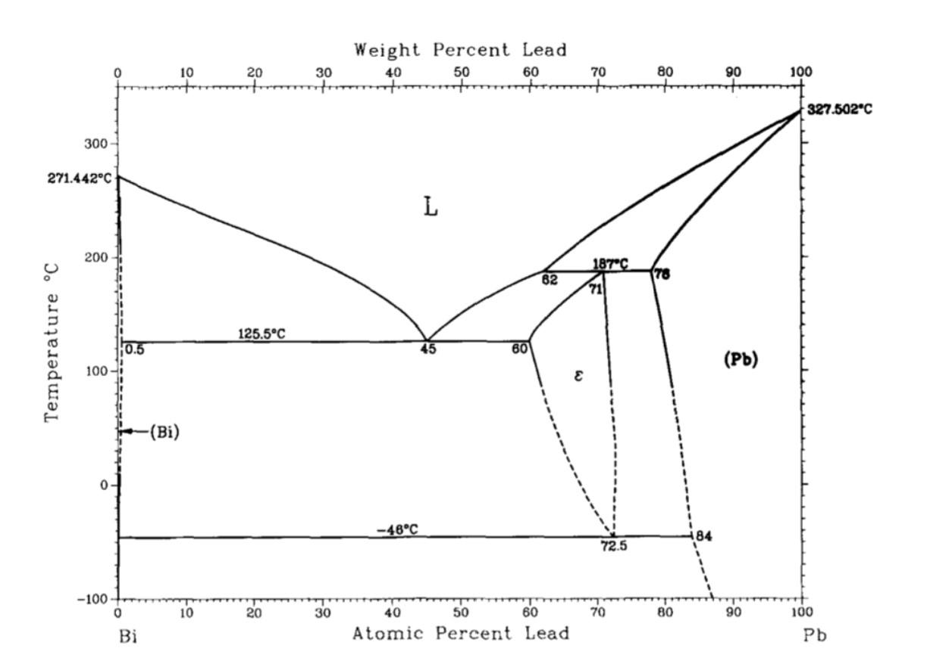
Lead Corrosion
The challenge of using heavy liquid metal coolant (lead and lead-bismuth) is the compatibility with structural materials at high temperature
Pb and lead-bismuth eutectic (LBE) provide highly corrosive conditions for most structural and cladding materials
This is most problematic for thin-walled components such as cladding tubes or heat exchangers
Corrosion in Pb and LBE is due to the dissolution of different constituent elements, their transport, and their chemical reactions with oxygen and nitrogen

Slide 22
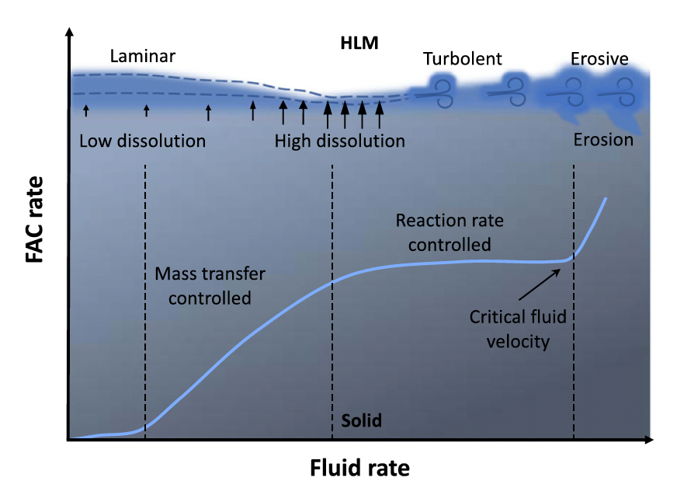
Flow Accelerated Corrosion
At low flow velocity, the corrosion is controlled by mass transfer, that is by diffusion of dissolved elements in the boundary layer
When the flow velocity increases, the thickness of the laminar boundary layer decreases, leading to an increase of the corrosion rate; the enhanced flow velocity locally reduces the corrosion product concentration at the interface, further promoting the diffusion process in the boundary layer

Slide 23
Flow Accelerated Corrosion
When the velocity is high enough to “clean” the surface of the solid metal from the corrosion products, the corrosion becomes flow-independent and therefore it is considered reaction rate controlled
At higher flow velocities, above a critical value, erosion-corrosion and also cavitation-corrosion may occur, leading to a significant increase of the corrosion rate

Slide 24
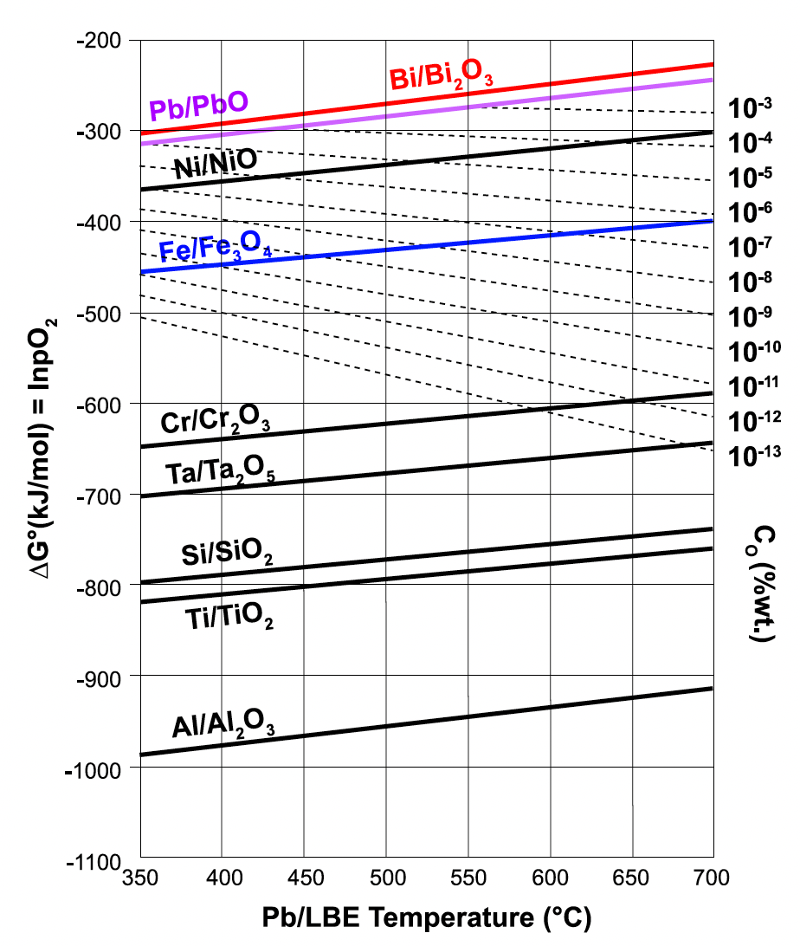
Impurities
A factor that has a considerable effect on the corrosion rate processes is the presence of nonmetallic impurities such as carbon, nitrogen, and oxygen
Impurity elements can take part in corrosion reactions and can form compounds with dissolved species
Oxides of the steel components are more stable than the LBE, and thus a Fe-Cr oxide layer on steel surfaces can protect the structural materials

Slide 25
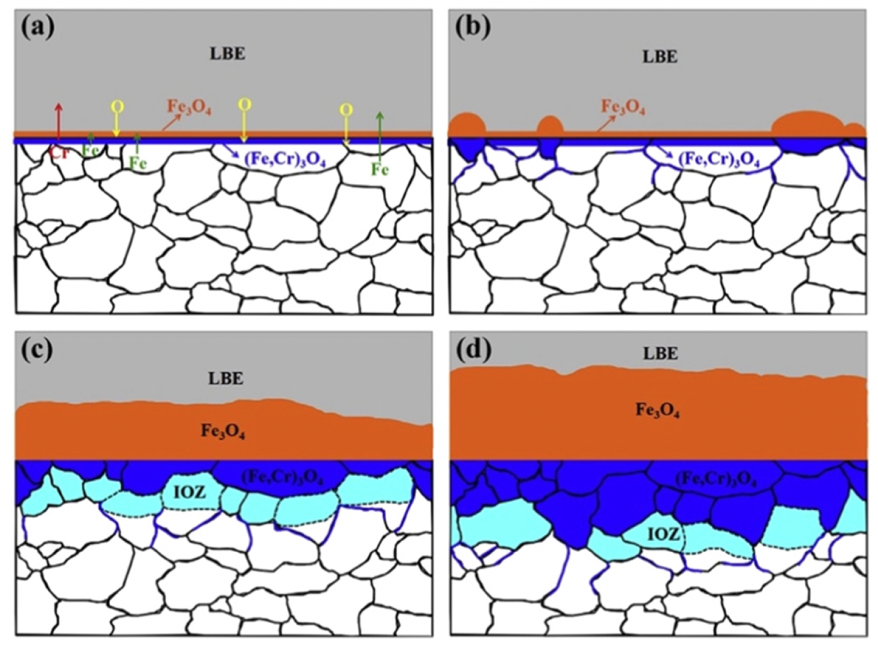
Oxide Passivation
Adequate control of the oxygen concentration allows one to maintain the Fe-Cr oxide film, without oxidizing the LBE
If insufficient oxygen is present, the steel will suffer dissolution corrosion
The oxide layer can form as a multi-layered structure dependent upon O content, temperature, and flow, with Fe3O4 and FeCrO2 phases

Slide 26
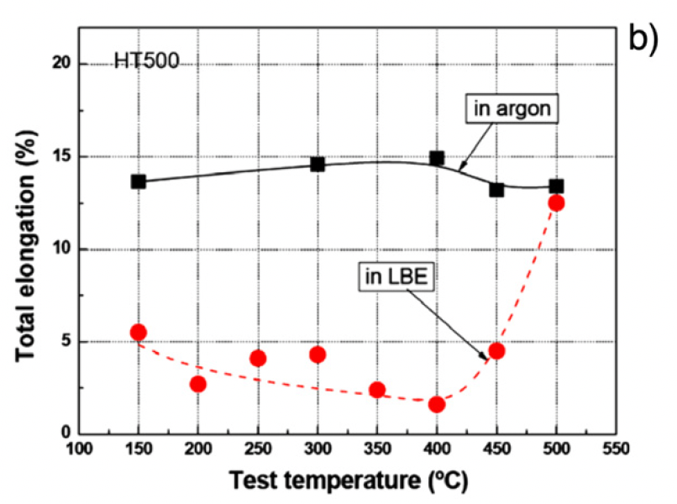
Mechanical Property Effects
Liquid metal embrittlement (LME) is a known phenomenon, but its mechanism is not fully understood
Contact with LM causes a decrease in ductility, resulting in a premature brittle failure in an otherwise ductile material
LME occurs by nucleation of a crack at the wetted surface of a solid and the subsequent propagation into the bulk until ultimate failure

Slide 27
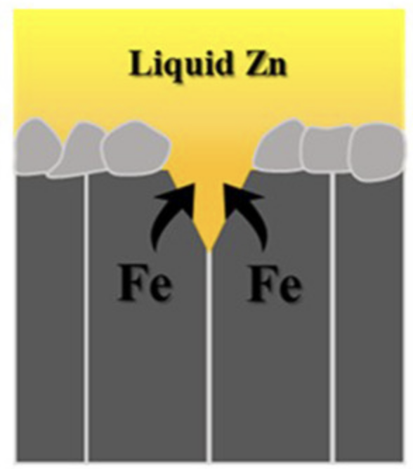
LME
The loss of ductility of solid metals when in contact with liquid metal appears to be limited to a particular temperature range known as the ductility trough
For the F/M T91 steel in liquid lead, a ductility trough between 160C and 425C was found
The ductility trough is detected by following the evolution of the ultimate tensile stress or energy to rupture with temperature
The working theory on LME is based on a reduction of the surface energy by absorption of liquid metal atoms at the crack tip of the solid

Slide 28
End of Module 3
This concludes our module 3
Exam will take place next Thursday (11/2)
Will cover molten salts, carbides and nitrides, and Pb-cooled reactors

